Slide 1
Improvement of downstream EAP notifications
and
The Delaware Aqueduct Bypass Tunnel
Upper Delaware Council
March 1, 2017
Adam Bosch, DEP Director of Public Affairs

Slide 2
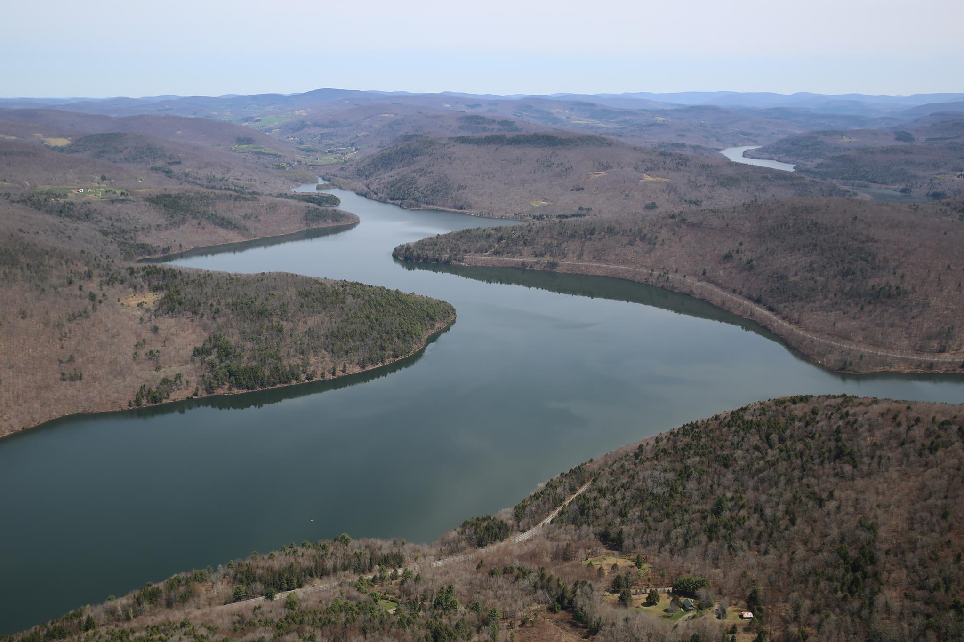
Presentation Agenda
Overview of New York City Water Supply System
Internal program to improve EAP notifications
Upcoming review by consulting engineers
Delaware Aqueduct Bypass Tunnel
Jobs
Questions and discussion
Pepacton Reservoir

Slide 3
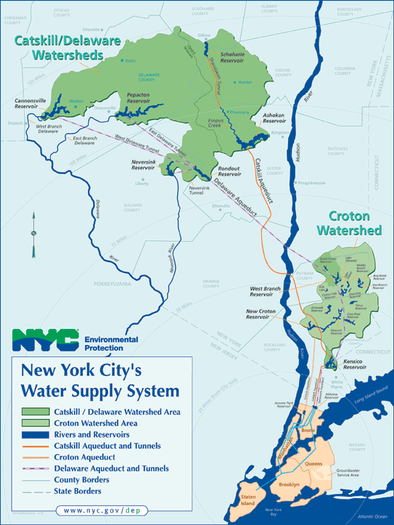
Primarily surface water
19 reservoirs + 3 lakes
580 billion gallon total reservoir storage capacity
9.5 million consumers (~1/2 New York State population)
Delivers more than 1 billion gallons of water each day
Watershed = 1,969 square miles (~1.2 million acres)
Watershed covers parts of 8 upstate counties in NY plus a small portion of CT
Nation’s largest unfiltered water supply
Conveyed by gravity alone

Slide 4
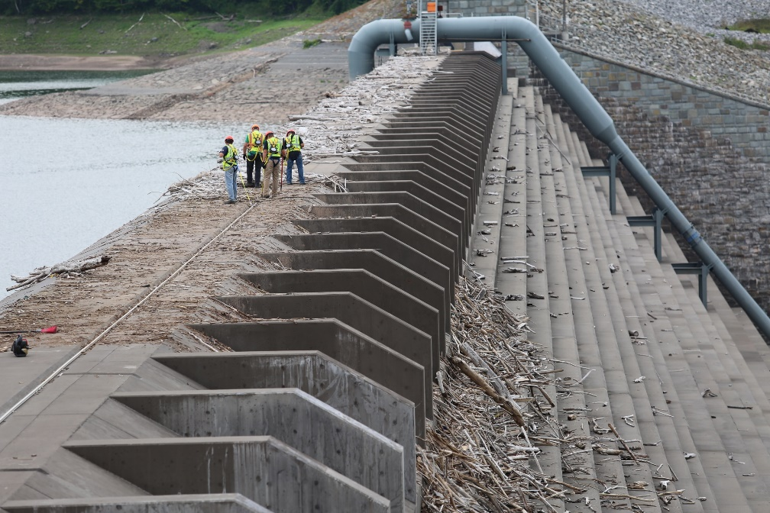
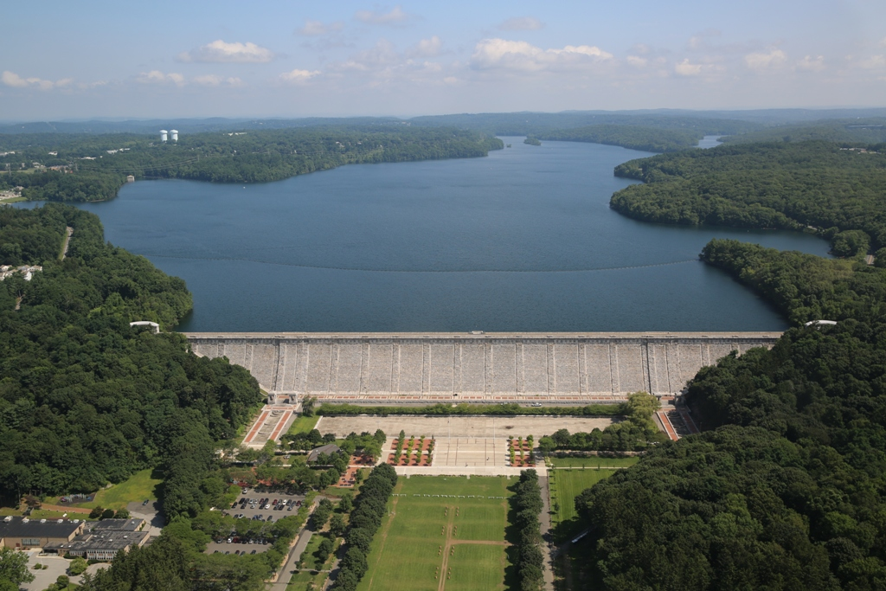
Dam Safety and Inspection
DEP owns 29 water supply dams that form our reservoirs
Operation and maintenance of dams in Catskills split among three regions
Robust program of inspections
  Daily by watershed maintainers and DEP police
  Monthly by supervisors
  Twice annual by licensed engineers
  Video surveillance at some dams
  Dam safety instrumentation fed into our 24/7 operations center
  Annual inspections by NYS DEC
  FERC inspections at Cannonsville
  Periodic assessments by consulting engineers who specialize in dams

Slide 5
Emergency Action Plans
DEP maintains Emergency Action Plans for all its high and medium hazard dams
EAP holders include local elected officials, emergency management, police, fire and others that have a formal role in emergency response
DEP hosts annual orientation and refresher for EAP holders
EAPs are regularly updated with contact information
New engineering analyses done on each dam every 10 year
Plans outline emergency outreach, inundation maps, etc.
Notes:
Fun Facts:
Hillview Reservoir is an essential component of the NYC water supply system, used to balance variations in the water supply from Kensico Reservoir in northern Westchester County and the actual usage in New York City. Ninety percent of the drinking water for New York City and a portion of the City of Yonkers drinking water passes through the Hillview Reservoir facility.
The reservoir has a total storage capacity of approximately 900 million gallons (2,840 acre-feet) and a surface area of approximately 90 acres. It is located on a 150-acre site
The reservoir was constructed between 1910 and 1915 and is completely enclosed by an approximately 55-acre man-made embankment. The embankment was constructed of local
material removed during the excavation of the reservoir area and placed around the edge of the reservoir basin. The embankment is 299 feet above MSL and is approximately 8,500 feet in
length, varying in height between 15 feet at the north side near the NYS Thruway to 60 feet at the south side of the reservoir. Hillview Reservoir is encircled by residential neighborhoods.

Slide 6
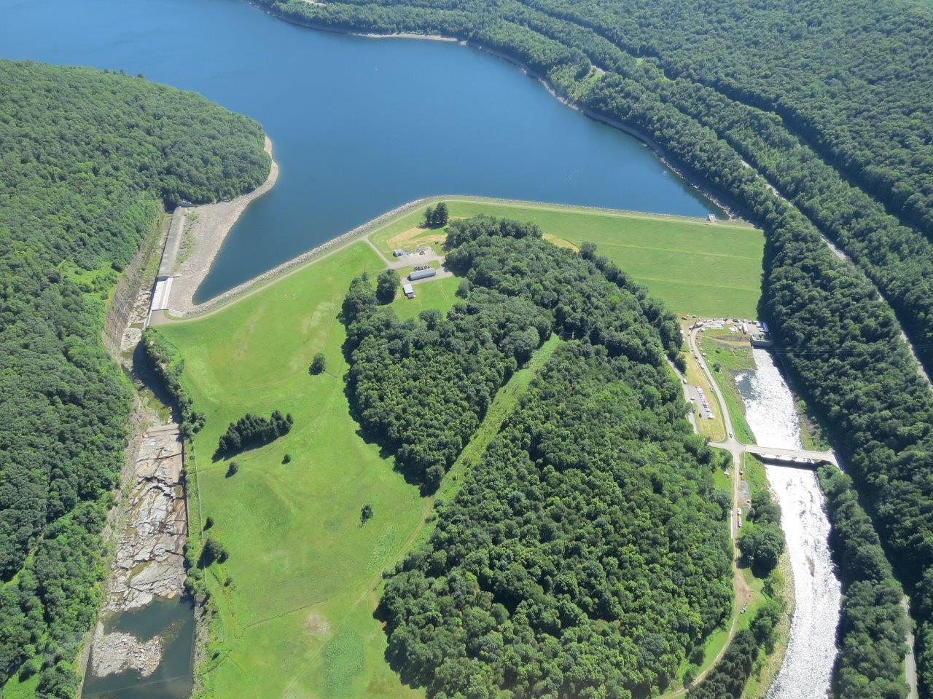
Current EAP Procedures
In an emergency situation, dam safety engineer could declare a condition orange or red
Declaration triggers calls to contacts on the notification flow chart in EAP
  NWS
  Federal, state and local emergency responders
Calls are made by Water Supply Control Center and DEP Police
NWS declares flash flood watch or warning that hits many devices
State and county authorities trigger their emergency action and communication plans
Notes:
Fun Facts:
Hillview Reservoir is an essential component of the NYC water supply system, used to balance variations in the water supply from Kensico Reservoir in northern Westchester County and the actual usage in New York City. Ninety percent of the drinking water for New York City and a portion of the City of Yonkers drinking water passes through the Hillview Reservoir facility.
The reservoir has a total storage capacity of approximately 900 million gallons (2,840 acre-feet) and a surface area of approximately 90 acres. It is located on a 150-acre site
The reservoir was constructed between 1910 and 1915 and is completely enclosed by an approximately 55-acre man-made embankment. The embankment was constructed of local
material removed during the excavation of the reservoir area and placed around the edge of the reservoir basin. The embankment is 299 feet above MSL and is approximately 8,500 feet in
length, varying in height between 15 feet at the north side near the NYS Thruway to 60 feet at the south side of the reservoir. Hillview Reservoir is encircled by residential neighborhoods.

Slide 7
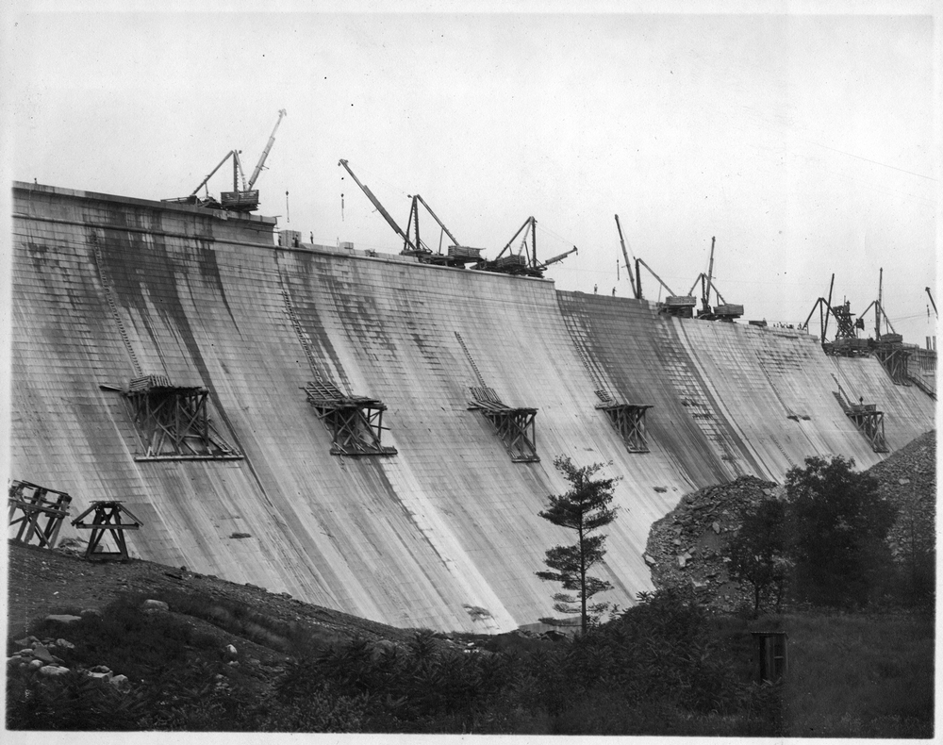
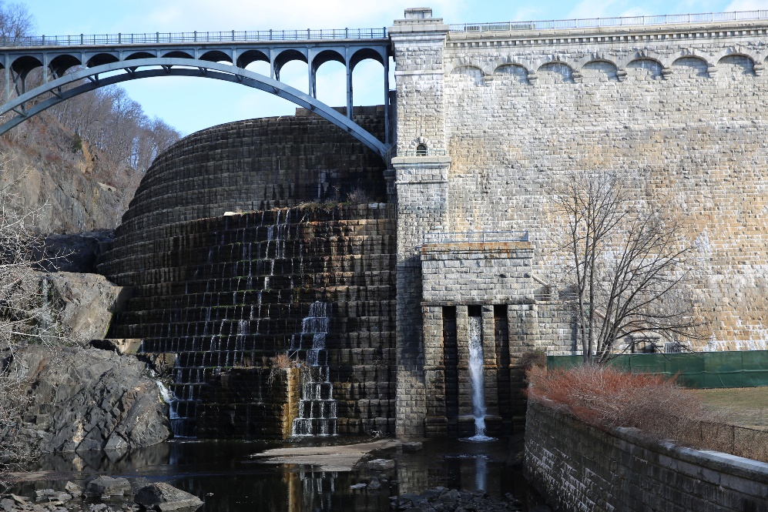
EAP Notification Improvement Plans
Two efforts to examine and improve the speed of EAP notifications
  Internal DEP effort that will focus on all dams
  External review by consulting engineer for Cannonsville due to FERC license requirements
Both have the same goal of reducing time for DEP notification to emergency management agencies and first responders
Focus on using computer software to expedite initial calls / mobilization
Notes:
Fun Facts:
Hillview Reservoir is an essential component of the NYC water supply system, used to balance variations in the water supply from Kensico Reservoir in northern Westchester County and the actual usage in New York City. Ninety percent of the drinking water for New York City and a portion of the City of Yonkers drinking water passes through the Hillview Reservoir facility.
The reservoir has a total storage capacity of approximately 900 million gallons (2,840 acre-feet) and a surface area of approximately 90 acres. It is located on a 150-acre site
The reservoir was constructed between 1910 and 1915 and is completely enclosed by an approximately 55-acre man-made embankment. The embankment was constructed of local
material removed during the excavation of the reservoir area and placed around the edge of the reservoir basin. The embankment is 299 feet above MSL and is approximately 8,500 feet in
length, varying in height between 15 feet at the north side near the NYS Thruway to 60 feet at the south side of the reservoir. Hillview Reservoir is encircled by residential neighborhoods.

Slide 8
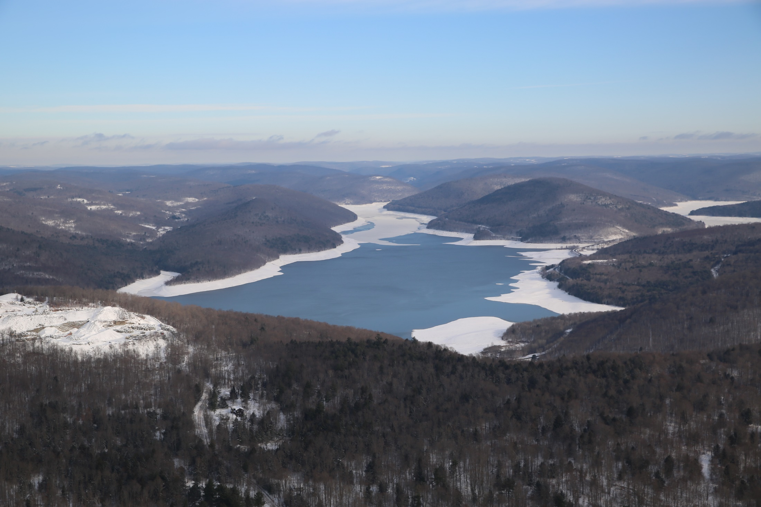
EAP Activation Notification Improvement Program
Efforts being piloted using Cannonsville Dam as a model
Will inform changes made to EAPs for all DEP dams
Utilizes notification software to contact all entities on notification chart simultaneously
Uses land-line phones, cell, text messaging, email and fax
Focus thus far has been on geographic areas within a one-hour travel time of flood wave from a catastrophic failure of the dam
Notes:
Fun Facts:
Hillview Reservoir is an essential component of the NYC water supply system, used to balance variations in the water supply from Kensico Reservoir in northern Westchester County and the actual usage in New York City. Ninety percent of the drinking water for New York City and a portion of the City of Yonkers drinking water passes through the Hillview Reservoir facility.
The reservoir has a total storage capacity of approximately 900 million gallons (2,840 acre-feet) and a surface area of approximately 90 acres. It is located on a 150-acre site
The reservoir was constructed between 1910 and 1915 and is completely enclosed by an approximately 55-acre man-made embankment. The embankment was constructed of local
material removed during the excavation of the reservoir area and placed around the edge of the reservoir basin. The embankment is 299 feet above MSL and is approximately 8,500 feet in
length, varying in height between 15 feet at the north side near the NYS Thruway to 60 feet at the south side of the reservoir. Hillview Reservoir is encircled by residential neighborhoods.

Slide 9
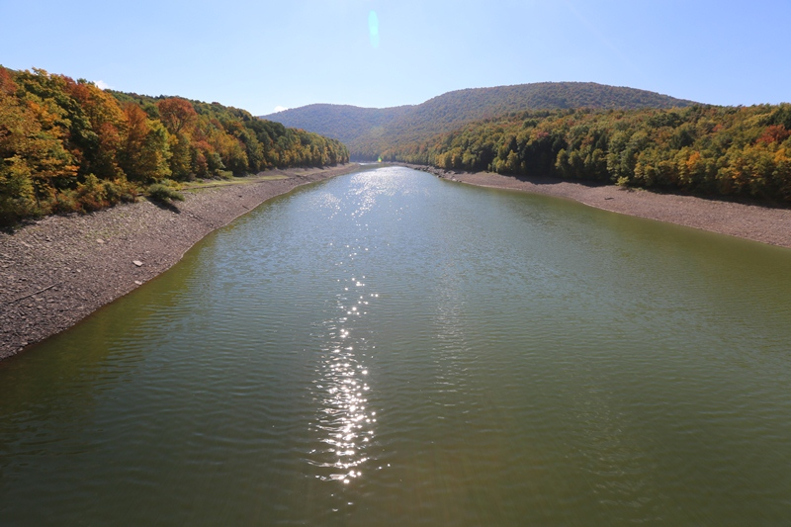
EAP Activation Notification Improvement Program
Internal planning efforts throughout CY 2017
Planning meeting with downstream partners in October 2017
Tabletop exercise with all downstream partners in December 2017
  Discuss the use of the tool
  Run a controlled tabletop exercise
  Make modifications
  Prepare for functional exercise with all emergency management offices, and state and federal agencies in 1-hour range
Notes:
Fun Facts:
Hillview Reservoir is an essential component of the NYC water supply system, used to balance variations in the water supply from Kensico Reservoir in northern Westchester County and the actual usage in New York City. Ninety percent of the drinking water for New York City and a portion of the City of Yonkers drinking water passes through the Hillview Reservoir facility.
The reservoir has a total storage capacity of approximately 900 million gallons (2,840 acre-feet) and a surface area of approximately 90 acres. It is located on a 150-acre site
The reservoir was constructed between 1910 and 1915 and is completely enclosed by an approximately 55-acre man-made embankment. The embankment was constructed of local
material removed during the excavation of the reservoir area and placed around the edge of the reservoir basin. The embankment is 299 feet above MSL and is approximately 8,500 feet in
length, varying in height between 15 feet at the north side near the NYS Thruway to 60 feet at the south side of the reservoir. Hillview Reservoir is encircled by residential neighborhoods.

Slide 10
EAP Activation Notification Improvement Program
Functional exercise held Jan. 25
Included participation from all entities in notification flow chart
DEP – BWS and Police
Delaware County – EMO/911
Broome County – EMO/911
Orange County 911
Pike County 911
Sullivan County EMO/911
Sussex Sheriff’s Office
Deposit PD
Hancock PD/Fire
Sanford Public Works
NYS – OEM/DEC/DOT/Police
National Weather Service
National Park Service
NJ State Police
Pennsylvania EMA
Notes:
Fun Facts:
Hillview Reservoir is an essential component of the NYC water supply system, used to balance variations in the water supply from Kensico Reservoir in northern Westchester County and the actual usage in New York City. Ninety percent of the drinking water for New York City and a portion of the City of Yonkers drinking water passes through the Hillview Reservoir facility.
The reservoir has a total storage capacity of approximately 900 million gallons (2,840 acre-feet) and a surface area of approximately 90 acres. It is located on a 150-acre site
The reservoir was constructed between 1910 and 1915 and is completely enclosed by an approximately 55-acre man-made embankment. The embankment was constructed of local
material removed during the excavation of the reservoir area and placed around the edge of the reservoir basin. The embankment is 299 feet above MSL and is approximately 8,500 feet in
length, varying in height between 15 feet at the north side near the NYS Thruway to 60 feet at the south side of the reservoir. Hillview Reservoir is encircled by residential neighborhoods.

Slide 11

EAP Activation Notification Improvement Program
Two-hour functional exercise involved a theoretical emergency at Cannonsville Dam
Software was used to send immediate notification to all participants at the same time
Traditional call-out list was also used by WSCC and DEP Police
Software was used to declare emergency, provide update, and to end the exercise
Participants thought software was effective and quick
  Problems with fax machines
DEP will look to incorporate in EAP
Notes:
Fun Facts:
Hillview Reservoir is an essential component of the NYC water supply system, used to balance variations in the water supply from Kensico Reservoir in northern Westchester County and the actual usage in New York City. Ninety percent of the drinking water for New York City and a portion of the City of Yonkers drinking water passes through the Hillview Reservoir facility.
The reservoir has a total storage capacity of approximately 900 million gallons (2,840 acre-feet) and a surface area of approximately 90 acres. It is located on a 150-acre site
The reservoir was constructed between 1910 and 1915 and is completely enclosed by an approximately 55-acre man-made embankment. The embankment was constructed of local
material removed during the excavation of the reservoir area and placed around the edge of the reservoir basin. The embankment is 299 feet above MSL and is approximately 8,500 feet in
length, varying in height between 15 feet at the north side near the NYS Thruway to 60 feet at the south side of the reservoir. Hillview Reservoir is encircled by residential neighborhoods.

Slide 12
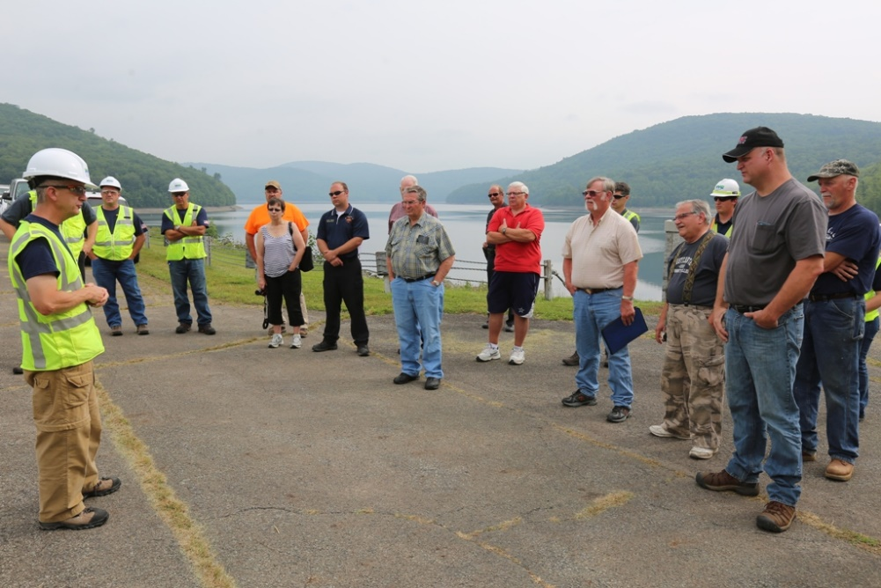
External Time-Sensitive Analysis for C’ville
Required by FERC as part of hydroelectric license
Schnabel Engineering Inc. (SEI) to investigate, document and recommend procedures for improving speed of notifications
BWS Dam Safety began working with SEI in late February to define scope and schedule of work
SEI work expected to be done by end of CY 2018
SEI will examine use of computer software, current EAP, etc.
Suggestions will inform changes throughout entire water supply
Notes:
Fun Facts:
Hillview Reservoir is an essential component of the NYC water supply system, used to balance variations in the water supply from Kensico Reservoir in northern Westchester County and the actual usage in New York City. Ninety percent of the drinking water for New York City and a portion of the City of Yonkers drinking water passes through the Hillview Reservoir facility.
The reservoir has a total storage capacity of approximately 900 million gallons (2,840 acre-feet) and a surface area of approximately 90 acres. It is located on a 150-acre site
The reservoir was constructed between 1910 and 1915 and is completely enclosed by an approximately 55-acre man-made embankment. The embankment was constructed of local
material removed during the excavation of the reservoir area and placed around the edge of the reservoir basin. The embankment is 299 feet above MSL and is approximately 8,500 feet in
length, varying in height between 15 feet at the north side near the NYS Thruway to 60 feet at the south side of the reservoir. Hillview Reservoir is encircled by residential neighborhoods.

Slide 13

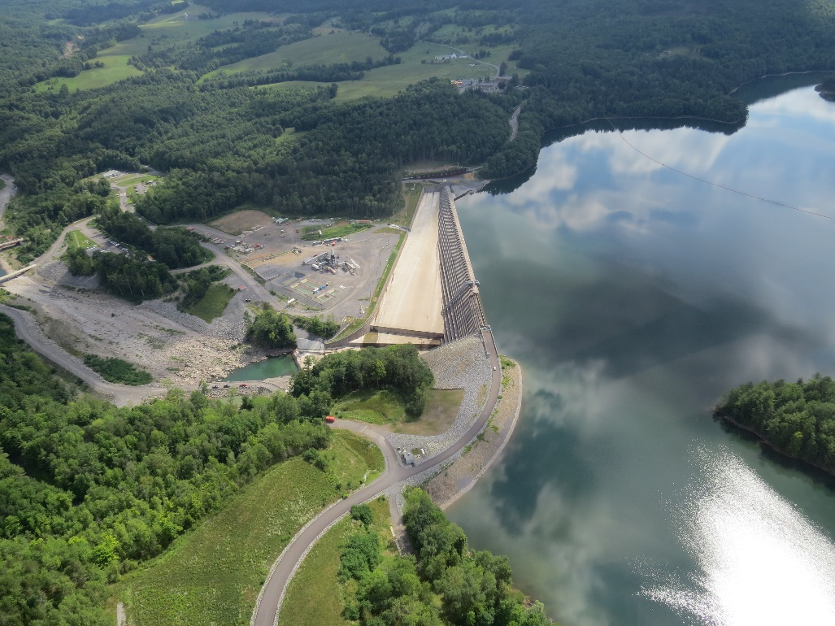
Other work on emergency communications
Annual EAP refresher trainings for all our dams – WOH, EOH, In-City
Annual meetings with all the county emergency management staff in the watershed
  EAP
  Unusual system operations
  Construction projects
County and state agencies reserve the responsibility for reaching out to their citizens in the case of an emergency at a DEP facility
Notes:
Fun Facts:
Hillview Reservoir is an essential component of the NYC water supply system, used to balance variations in the water supply from Kensico Reservoir in northern Westchester County and the actual usage in New York City. Ninety percent of the drinking water for New York City and a portion of the City of Yonkers drinking water passes through the Hillview Reservoir facility.
The reservoir has a total storage capacity of approximately 900 million gallons (2,840 acre-feet) and a surface area of approximately 90 acres. It is located on a 150-acre site
The reservoir was constructed between 1910 and 1915 and is completely enclosed by an approximately 55-acre man-made embankment. The embankment was constructed of local
material removed during the excavation of the reservoir area and placed around the edge of the reservoir basin. The embankment is 299 feet above MSL and is approximately 8,500 feet in
length, varying in height between 15 feet at the north side near the NYS Thruway to 60 feet at the south side of the reservoir. Hillview Reservoir is encircled by residential neighborhoods.

Slide 14
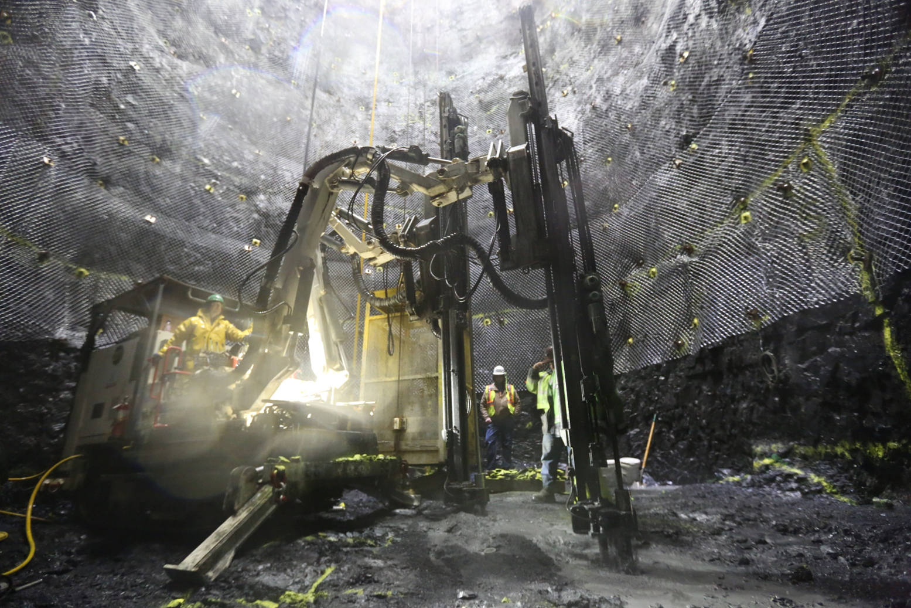
The Delaware Aqueduct Bypass Tunnel
The largest and most complex repair project in the 176-year history of New York City’s upland water supply
Total program cost $1.5 billion
Rehab of 100-year-old Catskill Aqueduct
Fixing or eliminating leaks in the Delaware Aqueduct
Building a new 2.5-mile-long tunnel 600 feet below the Hudson River
Expected completion in 2023
Notes:
14

Slide 15
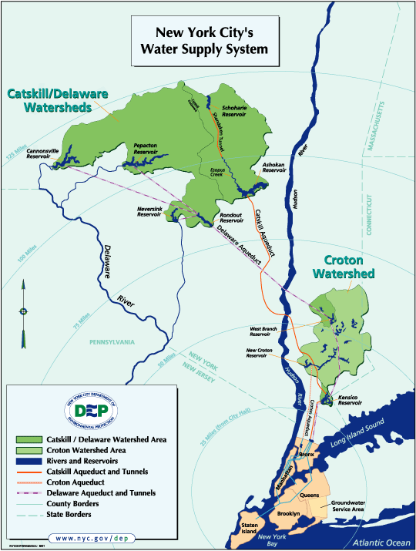
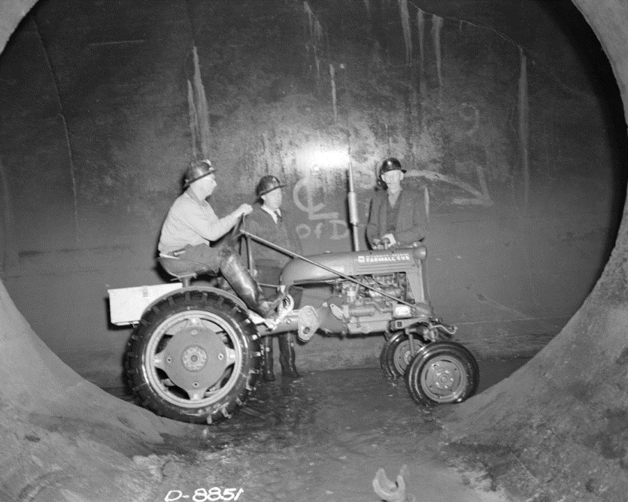
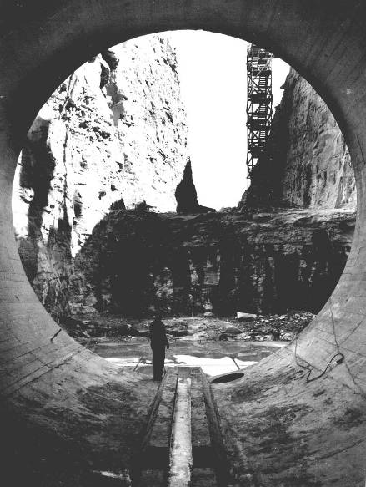
Delaware Aqueduct
85 miles long
World’s longest tunnel
Conveys water from Rondout Reservoir in Ulster County to Hillview Reservoir in Yonkers
Consists of three segments:
  Rondout-West Branch Tunnel- 44 miles
  West Branch-Kensico Tunnel- 27 miles
  Kensico-Hillview Tunnel- 14 miles
Notes:
300 to 2,000 Feet Below Ground, 45 Miles Long; 13.5 Feet Diameter, 900 MGD Design Capacity, Activated in 1944, Last Inspected in the ‘dry’ in 1958
Leaks Approximately 15-35 MGD

Slide 16
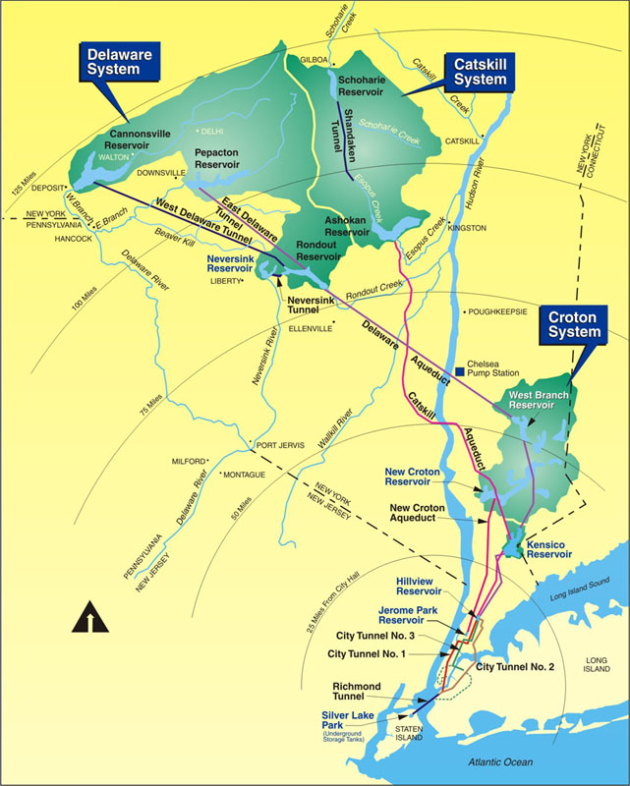
The Rondout-West Branch Tunnel
Conveys Delaware System Supply across Hudson River
  In service since 1944
  Last drained 1957-1958
Critical system component that typically conveys 50-60 percent of New York City’s drinking water
Tunnel dimensions
  44 miles long
  13.5 feet diameter
  600 to 2,400 feet below the surface
Rondout-West Branch (RWB) Tunnel
16

Slide 17
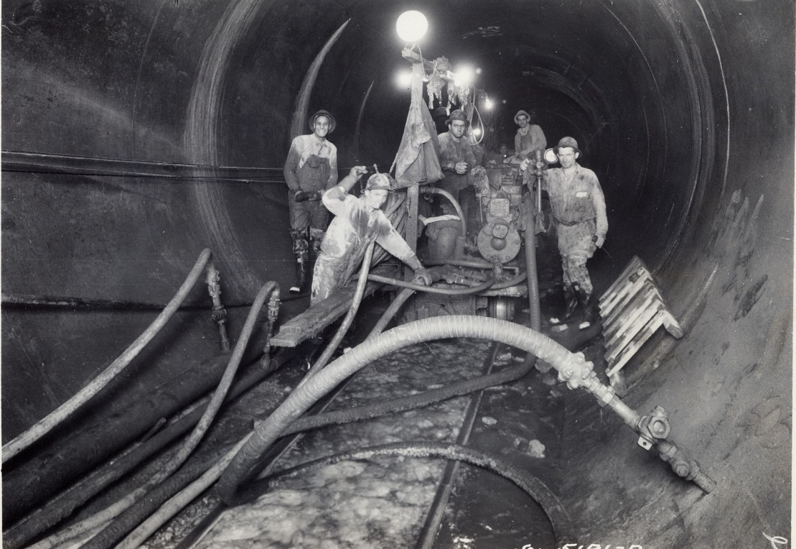
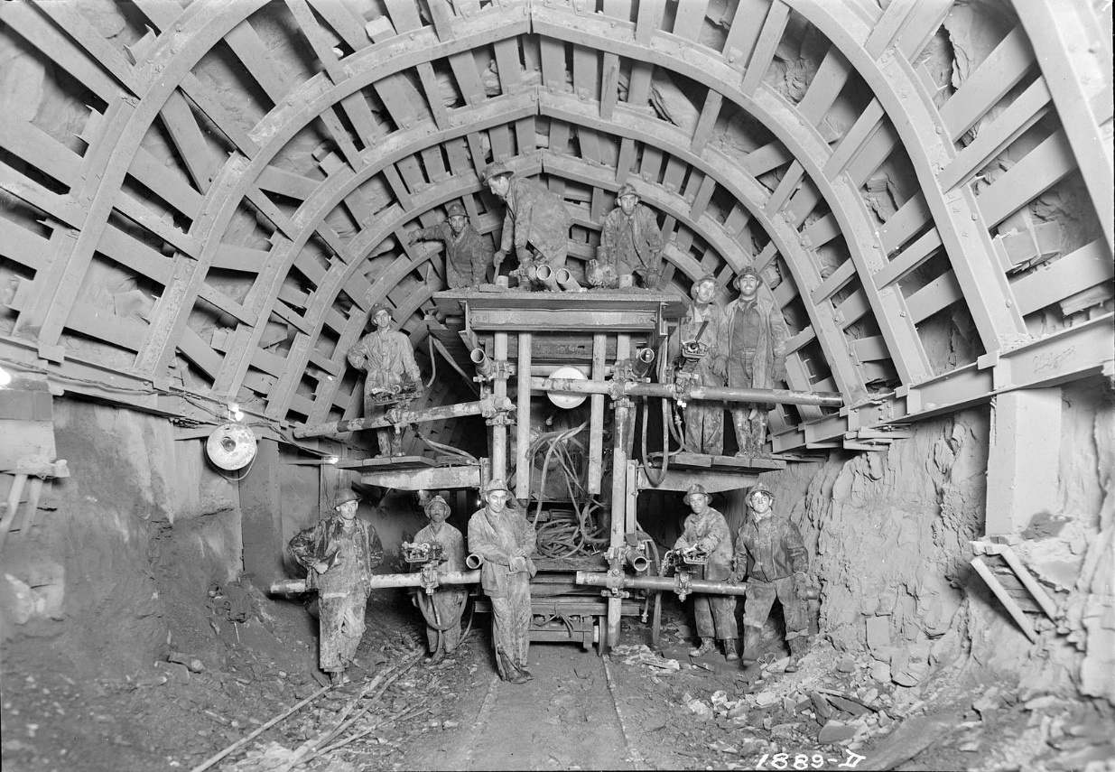
The Rondout-West Branch Tunnel
Workers in the Rondout-West Branch Tunnel
Workers on the drilling rig in the Rondout-West Branch Tunnel

Slide 18
The Rondout-West Branch Tunnel
Suspected leak first discovered in 1990 by a utility worker at a power plant along the Hudson River
Total leakage rate estimated at approx. 20 MGD
Leakage located in Wawarsing and Newburgh
Approximately 95 percent is leaking from Newburgh section
Difficult conditions were encountered during construction – faulted and fractured limestone
Steel lining installed through these sections to provide support for the tunnel
Rondout-West Branch (RWB) Tunnel

Slide 19
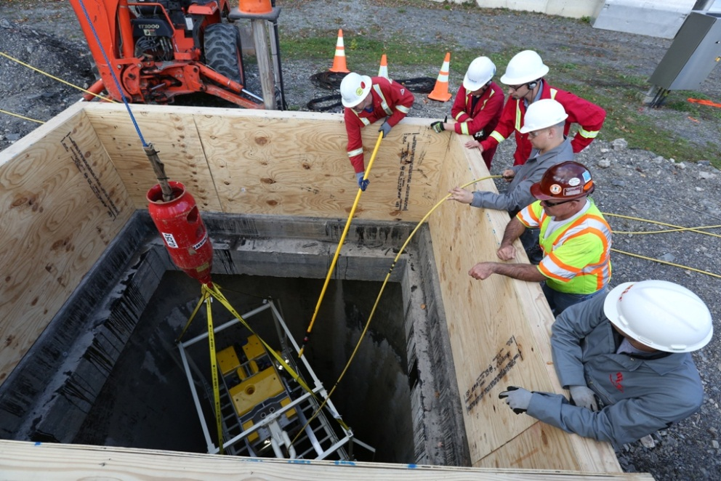
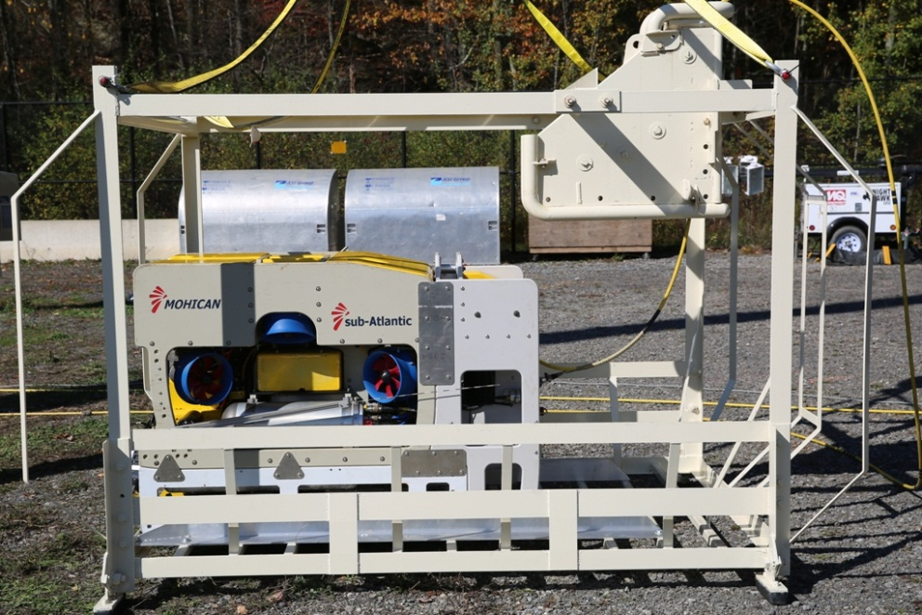
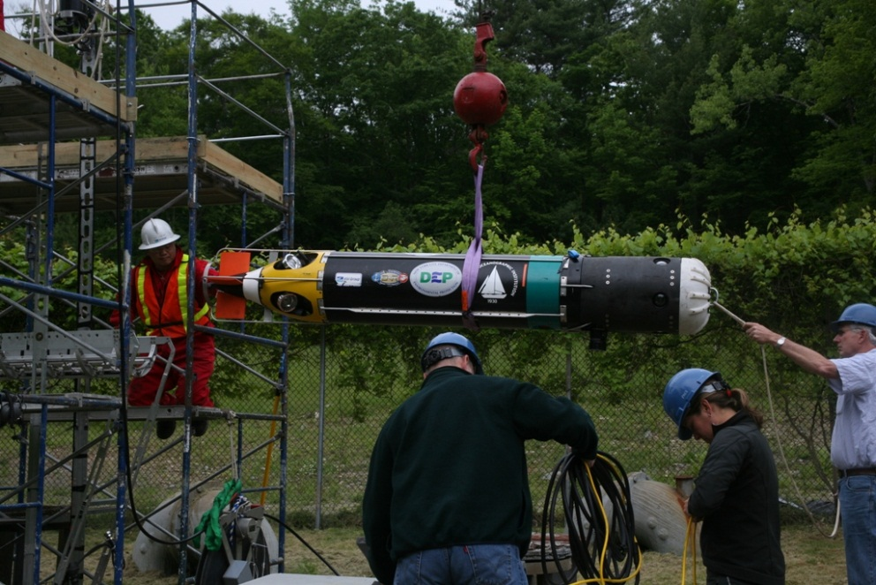
Ongoing leak monitoring
Top: A remote-operated vehicle was lowered into the Delaware Aqueduct in 2015 to pinpoint leak locations in Wawarsing. Leak < 1 MGD.
Bottom: DEP inspected the Rondout-West Branch Tunnel three times with an automated underwater vehicle. The AUV showed the leaks are stable.

Slide 20
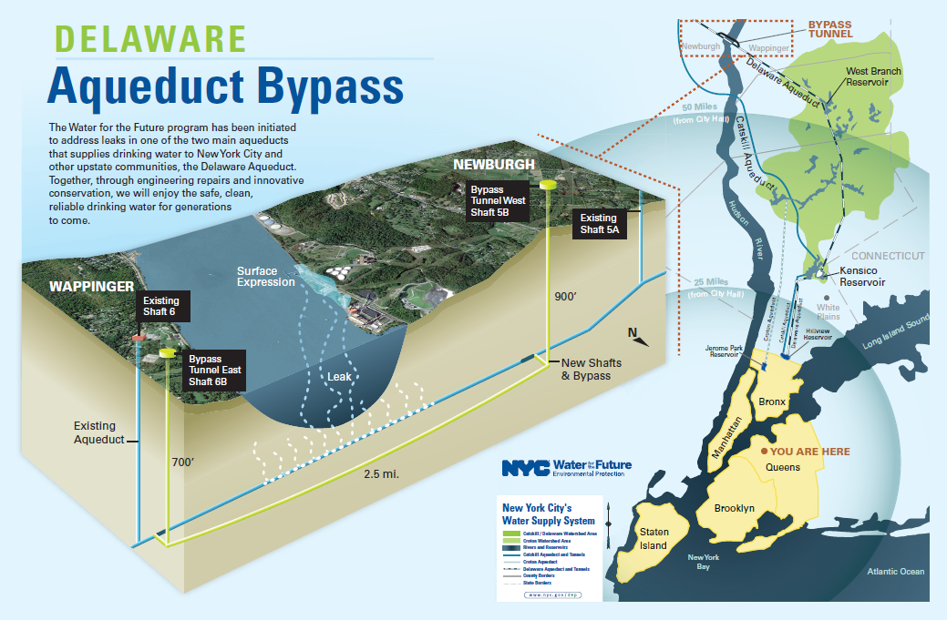
Bypass tunnel schematic
Newburgh,
New York
Wappinger,
New York

Slide 21
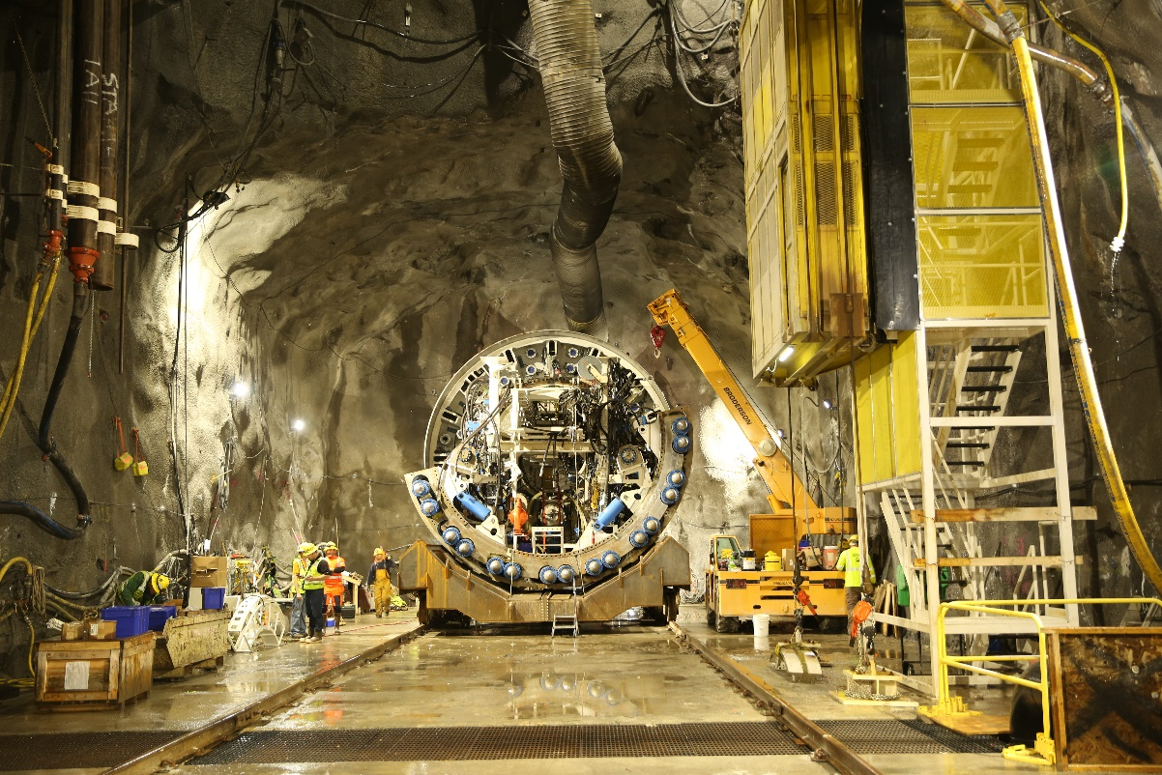
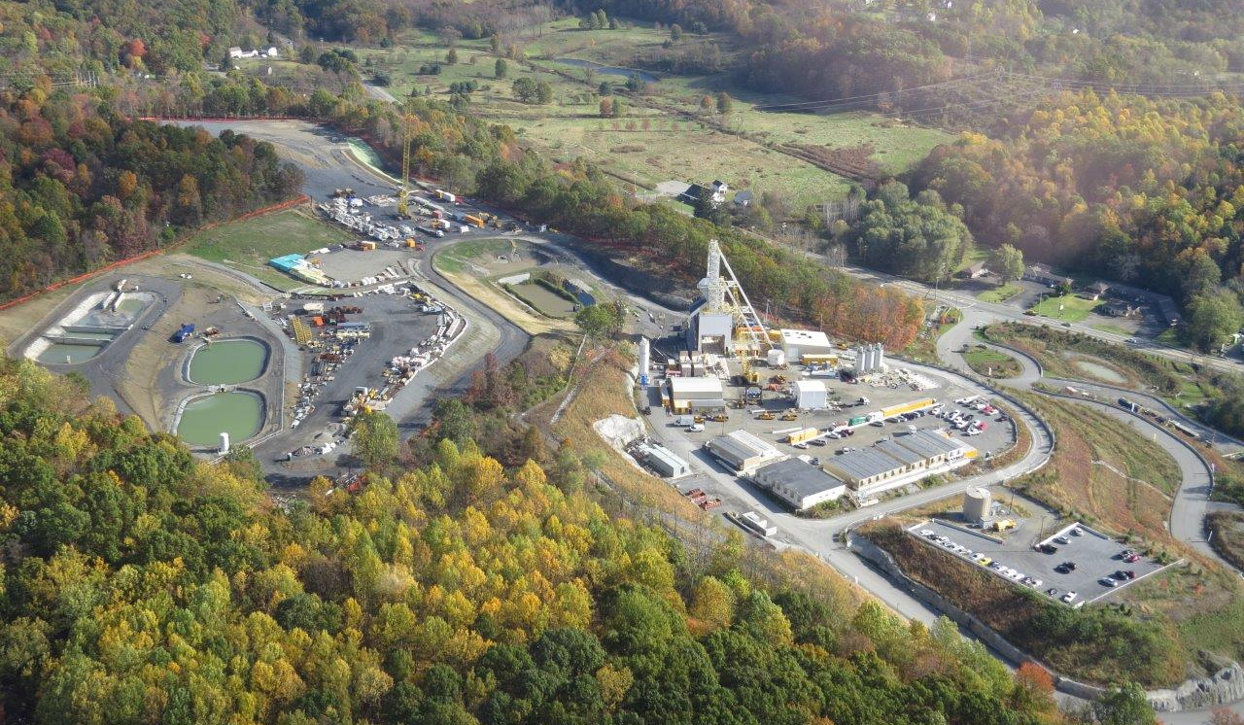
Status of current work
Shafts completed in March 2017– roughly 845 feet at Newburgh, 675 feet at Wappinger
Bell-out chamber (40 X 40 X 100) completed at bottom of Shaft 5B
Workers now using TBM to drill tunnel north and then east under Hudson River
Tunneling will move at a pace of approximately 50 feet per day at full production
Crews working 24 hours

Slide 22
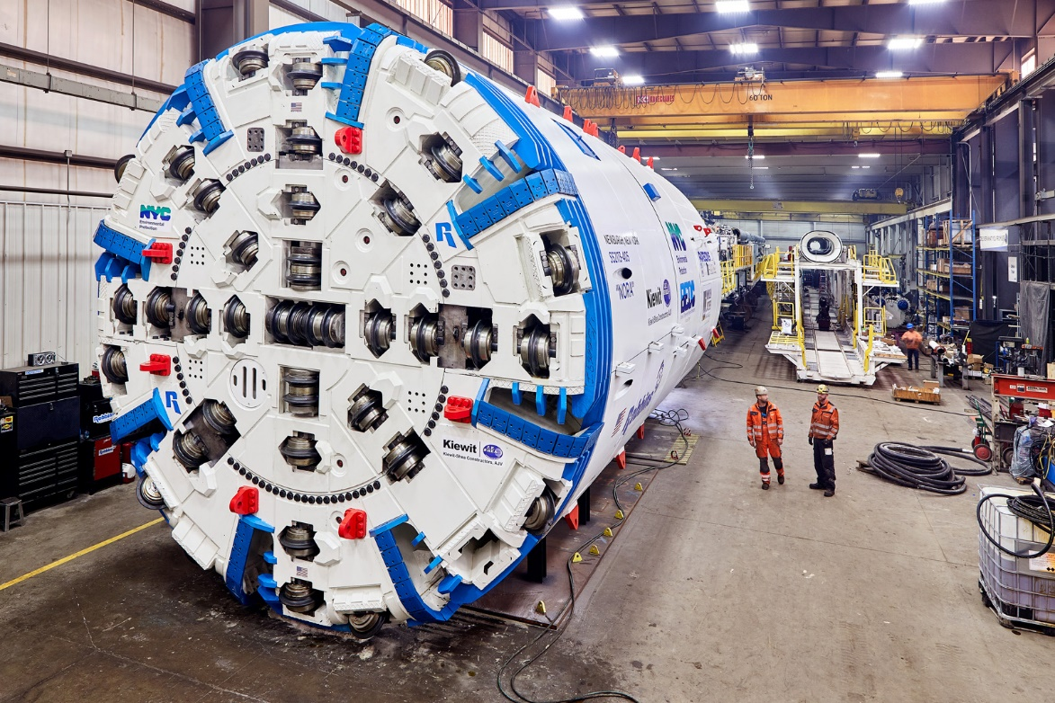
Delaware Aqueduct Bypass Tunnel
Completed bypass tunnel will be 14 feet (4.2 m) diameter
9,200-foot steel liner (2,804 m)
Tunnel boring machine will arrive on site in spring/summer 2017
TBM will drill about 50 feet (15 m) per day
Built to withstand 20 bar of pressure (300 psi)
Historic records show inflows of more than 1,500 gallons per minute (5,678 L / minute)
Bypass tunnel was designed in-house by DEP

Slide 23
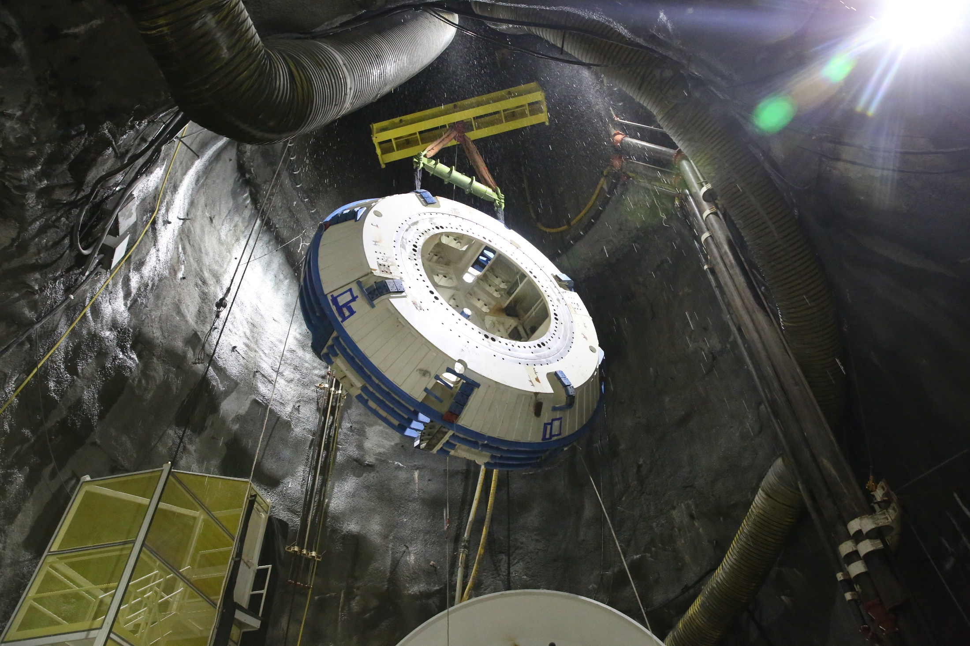
Delaware Aqueduct Bypass Tunnel

Slide 24
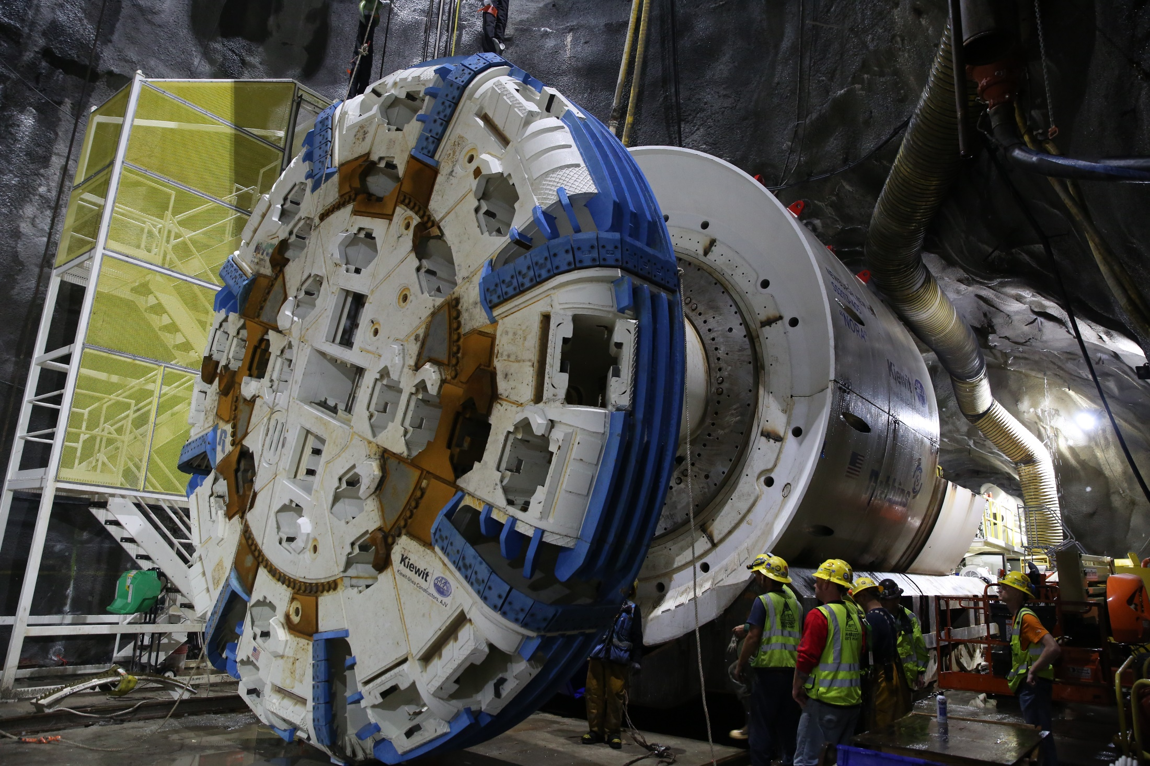
Delaware Aqueduct Bypass Tunnel

Slide 25
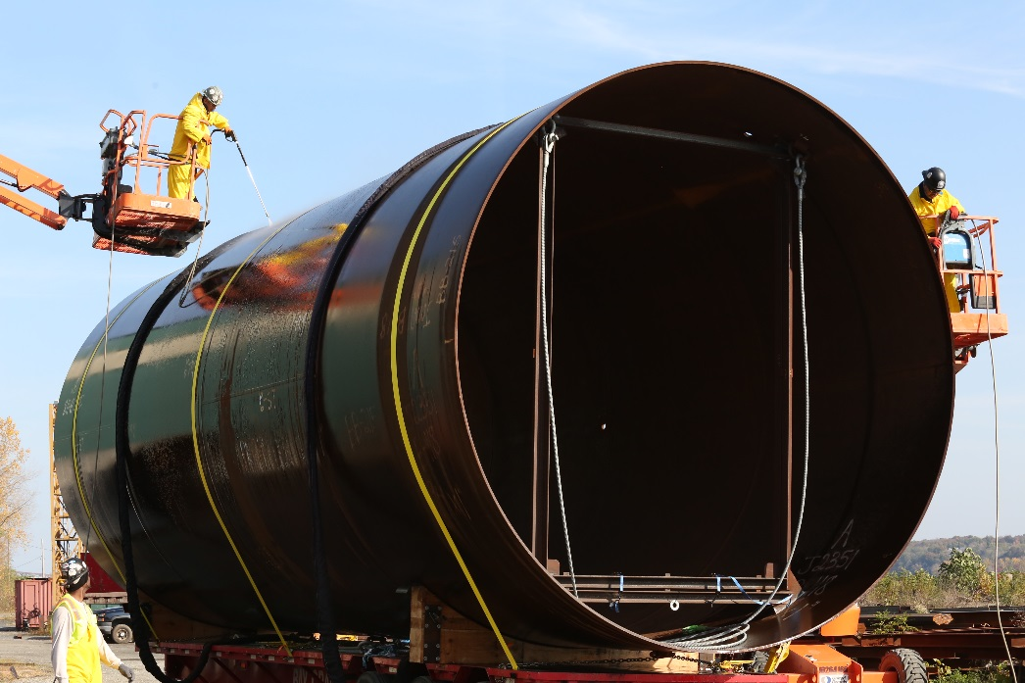
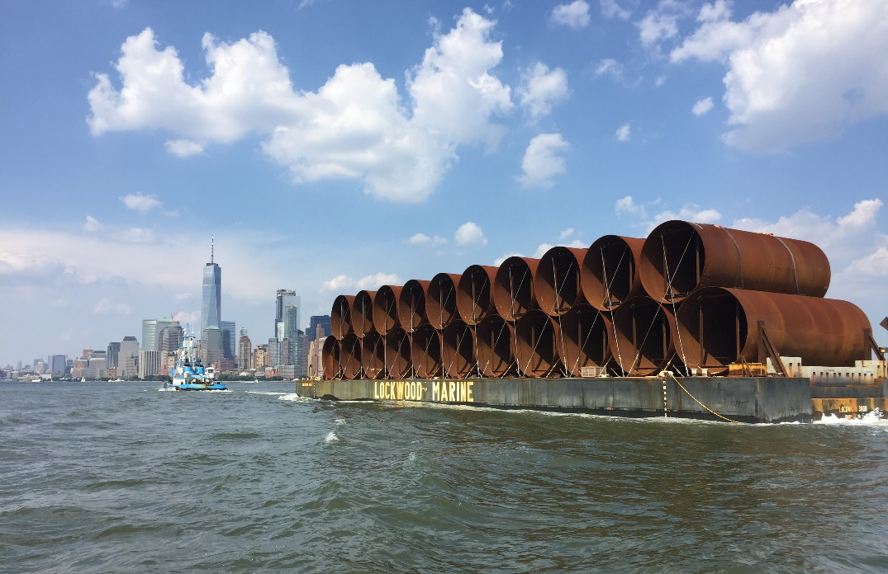
Arrival of steel interliner sections
Steel interliner sections have all arrived at Hudson River port in Newburgh
11 total shipments received in 2016-2017
9,200 linear feet of liner
Delivered in 230 sections that are 40 feet each
16 feet in diameter
Each 40-foot section weighs 80,000 pounds
Liners are cleaned and stored in Newburgh until needed in 2019

Slide 26
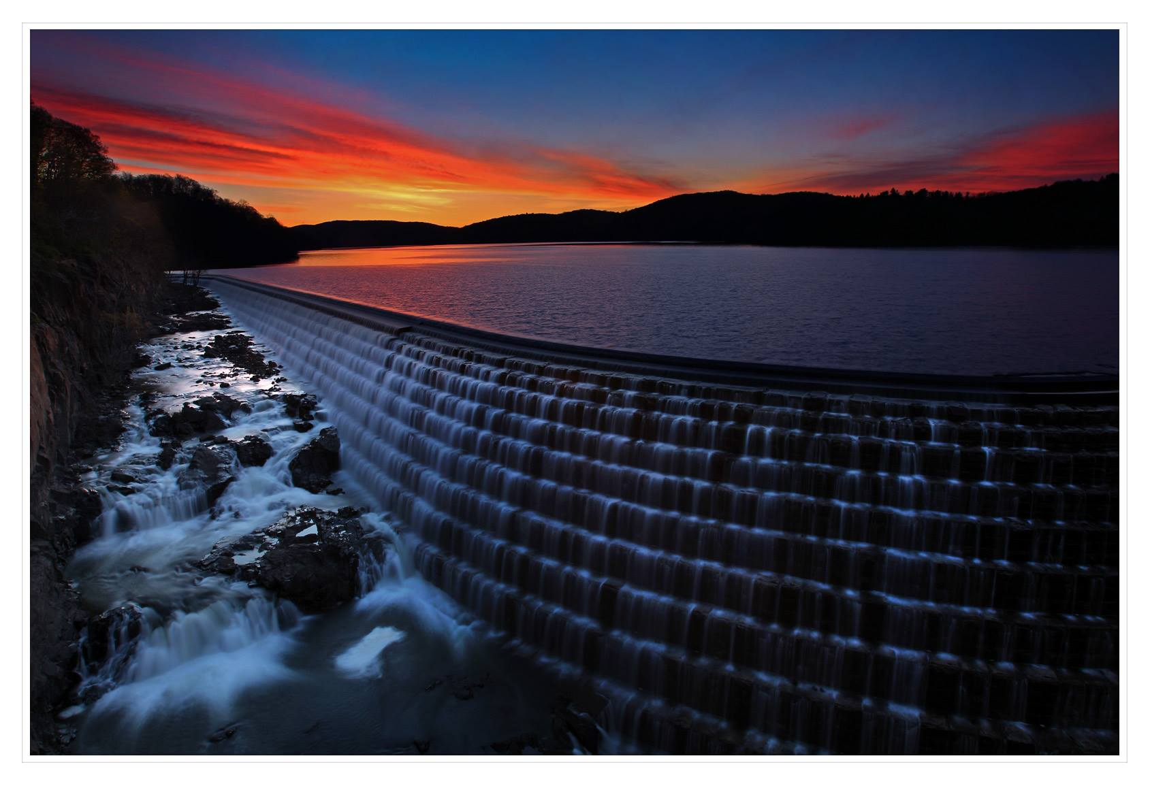
Water supply augmentation
Perhaps the biggest challenge for this repair project: Where would NYC get its water during the shutdown of the Delaware Aqueduct?
Catskill Aqueduct Rehabilitation – 40 MGD
Cross River and Croton Falls pumping stations – 240 MGD
Restart of the Croton System – 290 MGD
New Croton Dam Spillway

Slide 27
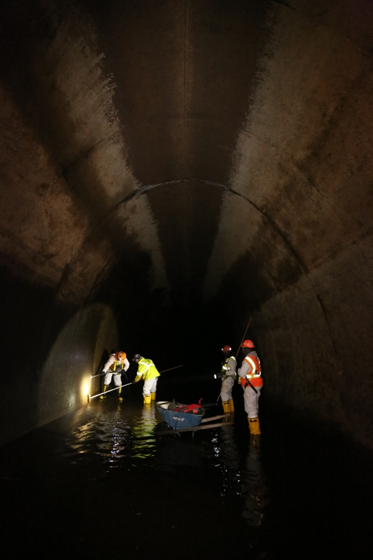
Catskill Aqueduct Repair and Rehabilitation
Upper Catskill Aqueduct extends approximately 74 miles from Ashokan to Kensico Reservoir
Historical capacity = 660 MGD
Capacity has been reduced by biofilm; now approx. 590 MGD
Biofilm consists of a filamentous bacteria attached to naturally occurring iron and manganese
Creates friction in the aqueduct that slows down the flow of water
Removing the biofilm will increase the speed of the water and the Catskill Aqueduct’s daily capacity
Similar to Winnipeg, Canada

Slide 28
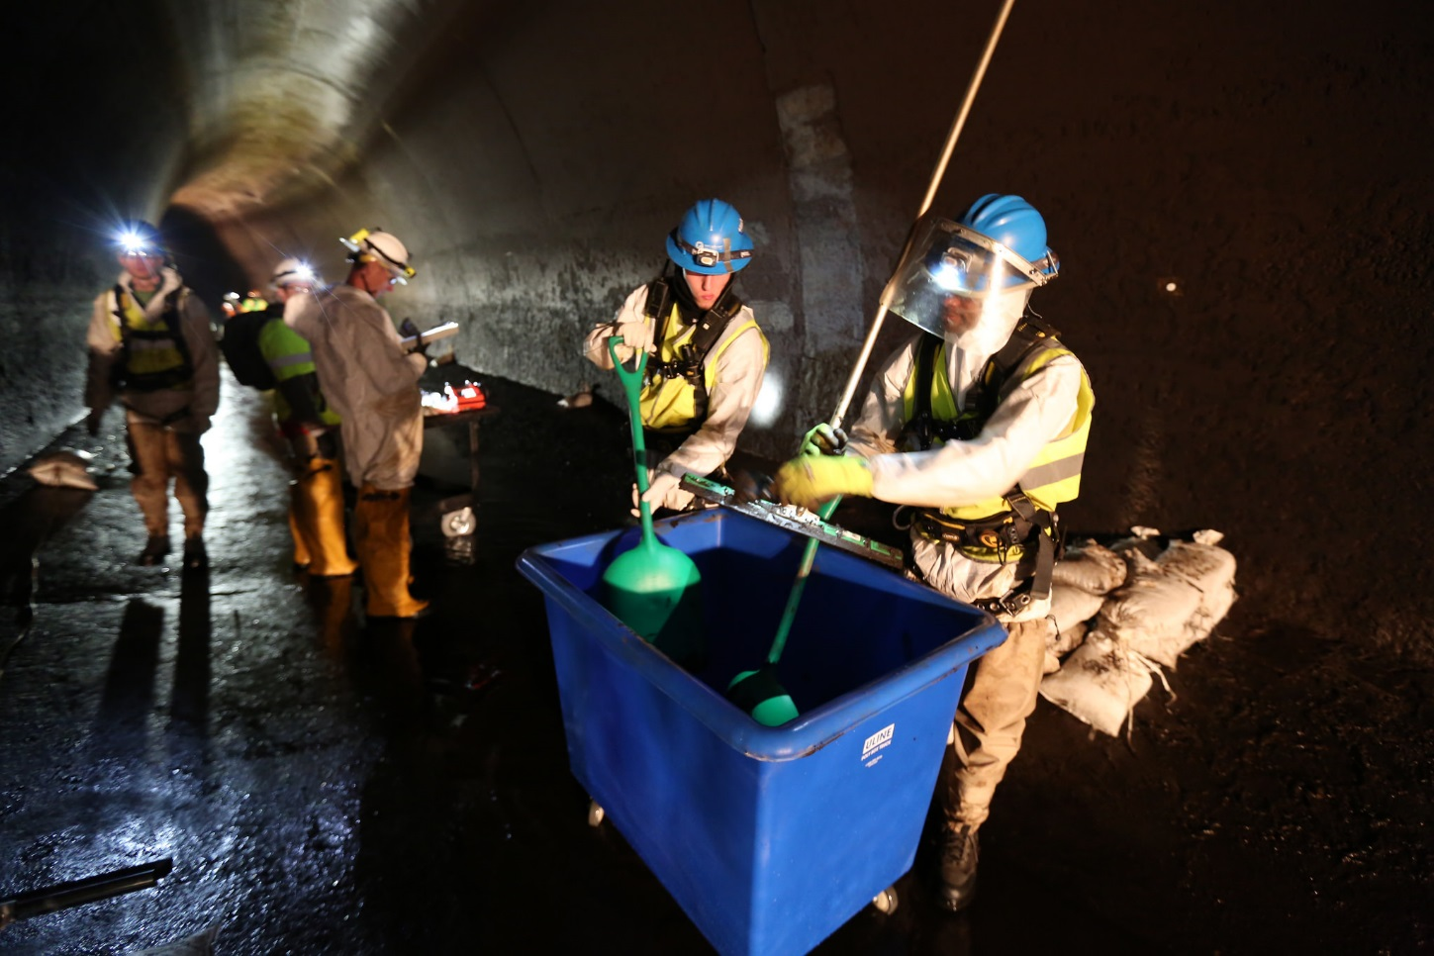
Catskill Aqueduct Repair and Rehabilitation
Brief shutdowns in 2018-2020
Biofilm will be power washed or scraped off the tunnel lining
Century-old valves to be replaced
Restore roughly 40 MGD capacity
Cost approx. $150 million

Slide 29
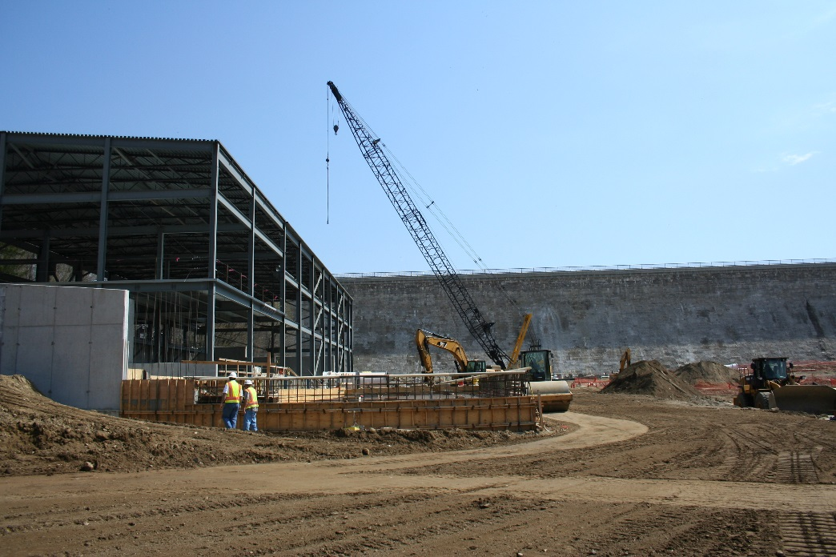
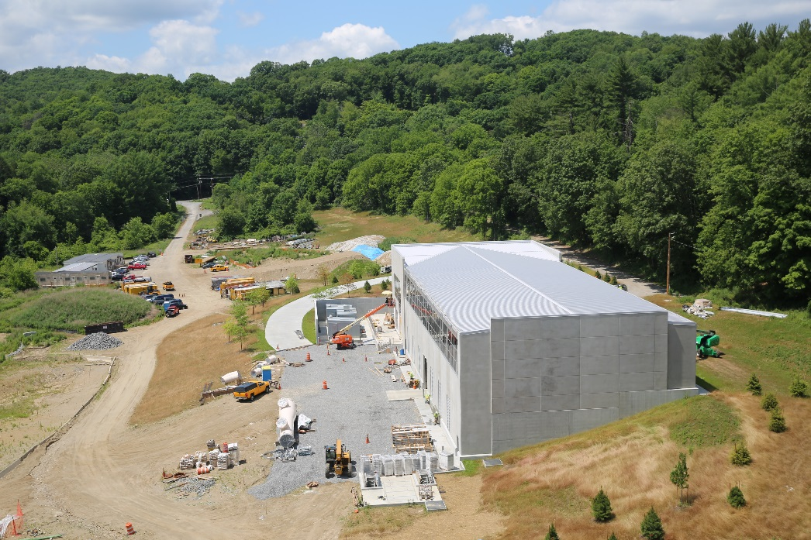
Pumping Station Upgrades
Pumping stations at Croton Falls and Cross River can put water into Delaware Aqueduct below project site
$60 million project to upgrade
Hydraulic pumps that worked in reservoir head being replaced by electric pumps
Combined capacity of 240 MGD
Facilities helpful for bypass tunnel shutdown and future drought protection
Only three upstate locations use electricity to convey water – other is Hudson River Pumping Station in Wappinger
Above: Croton Falls Pumping Station May 2015 and August 2016

Slide 30


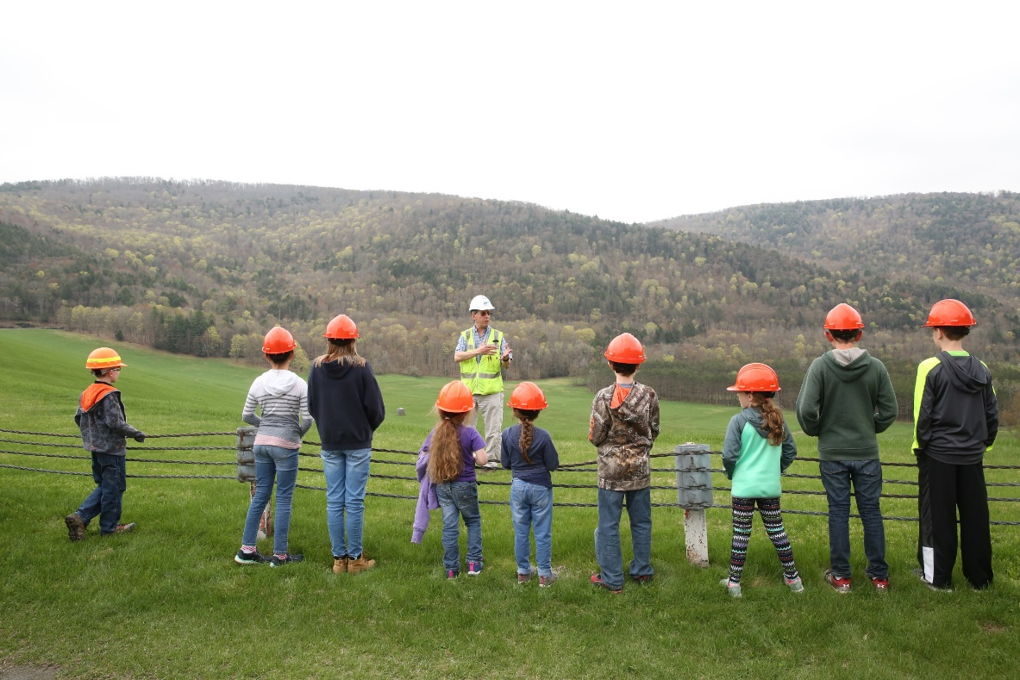

We need your small humans….

Slide 31
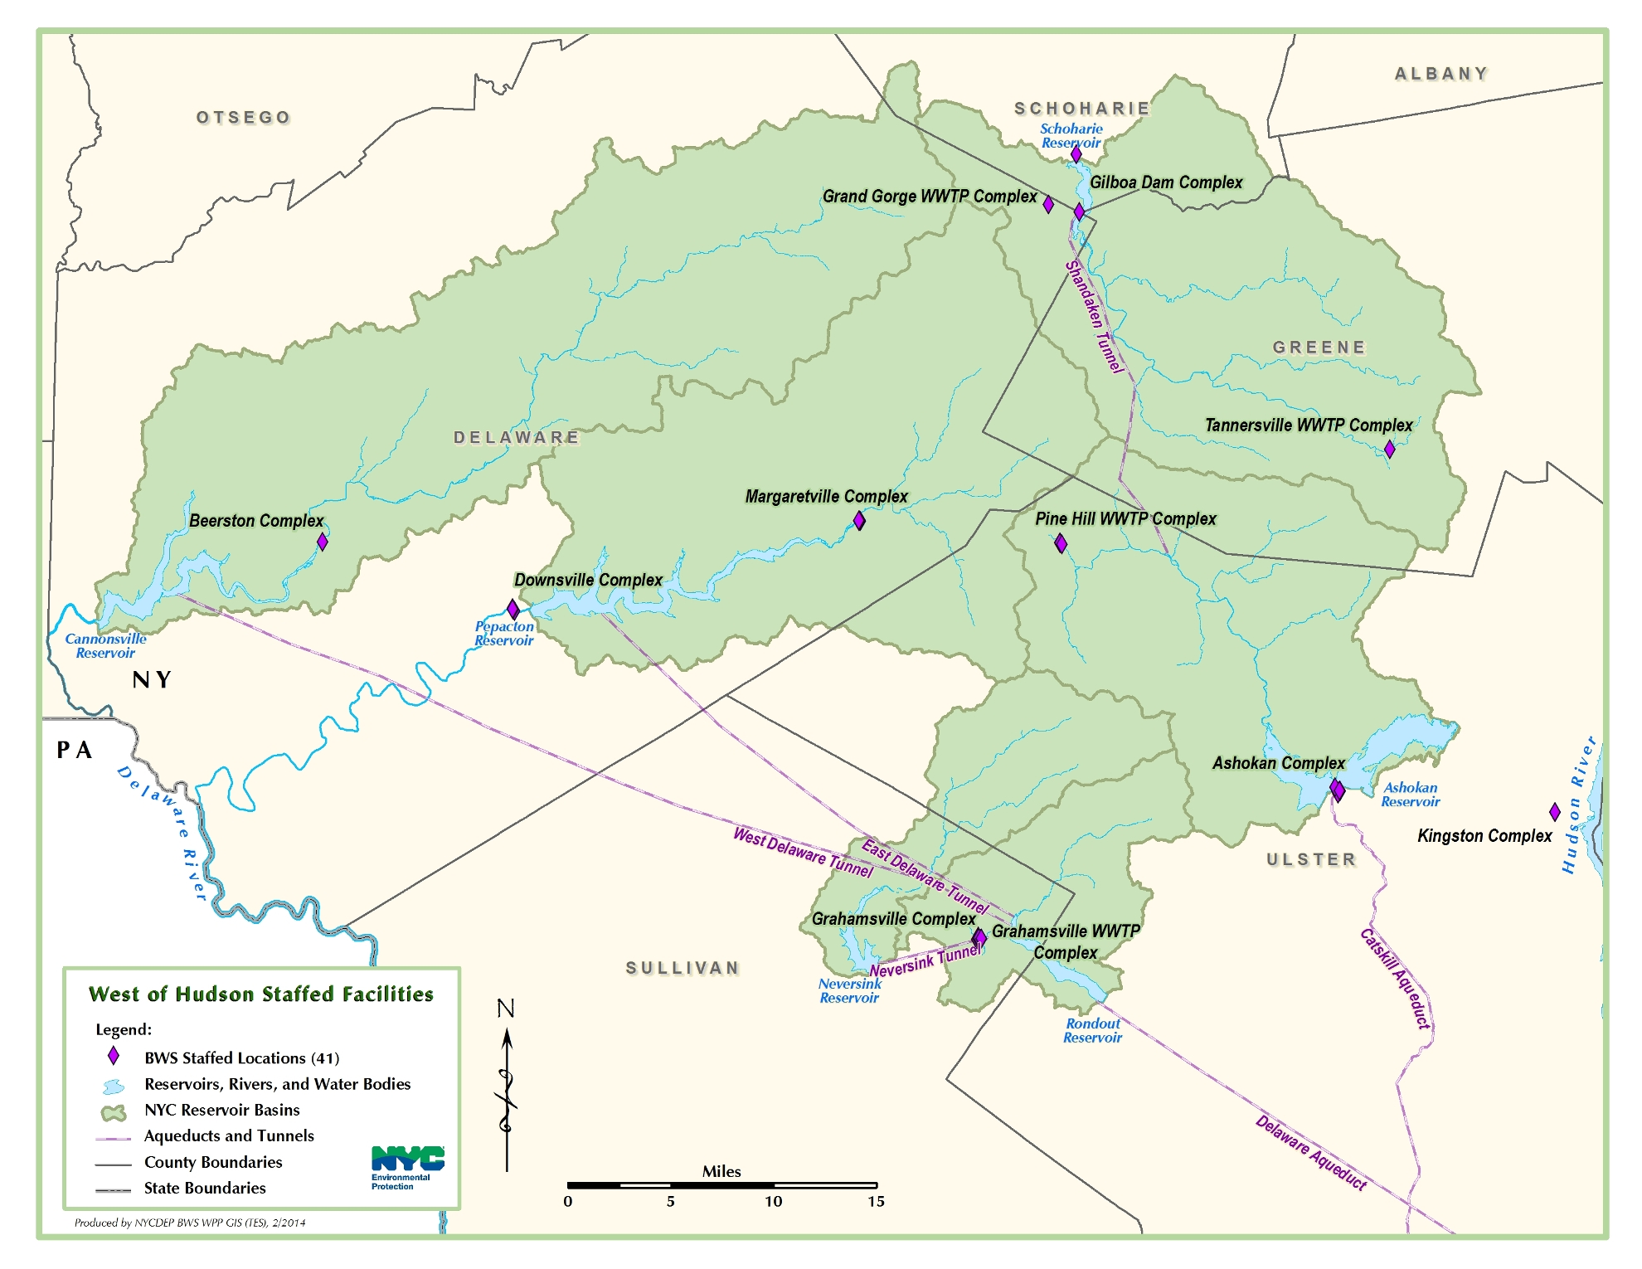
WOH Staffed Facilities
7 Employees
12 Employees
6 Employees
10 Employees
8 Employees
42 Employees
63 Employees
111 Employees
201 Employees
PJWWTP
6 Employees

Slide 32
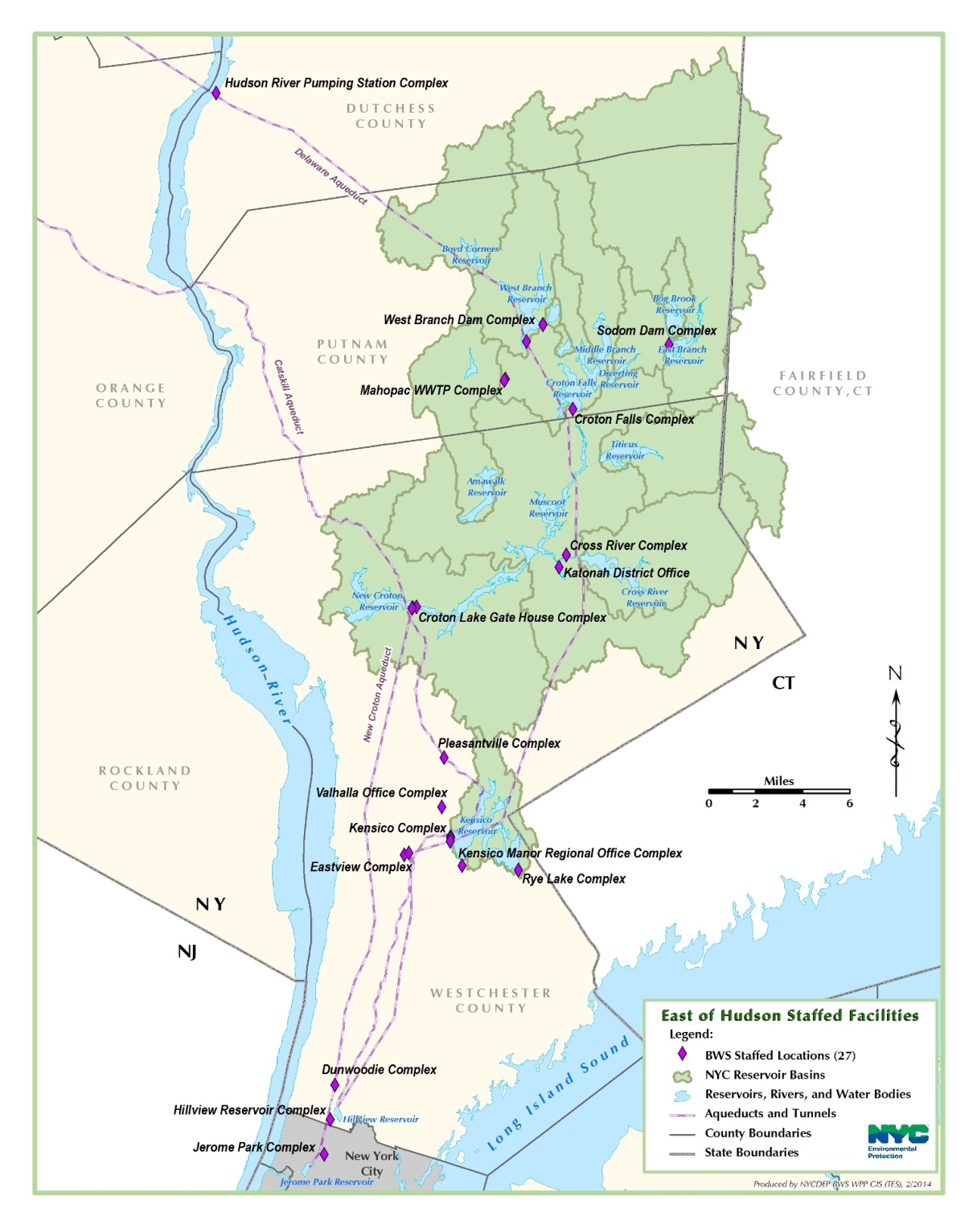

EOH / In-City Staffed Facilities
Employee Breakdown:
FY17 Authorized: 1,044 Employees
987 Employees on Board
19 Employees
36 Employees
3 Employees
6 Employees
11 Employees
137 Employees (Valhalla)
42 Employees (Hawthorne Lab)
16 Employees
Other Bureaus with an Upstate Presence:
OIT- 13 Employees
BLA/Law- 6 Employees
BEDC- 35 Employees
BPS- 228 Employees (Approx)
BPA- 2 Employees
Total- 283 Employees
21 Employees
10 Employees
70 Employees
52 Employees
70 Employees
(Croton Filter Plant)
27 Employees
(Reservoir Operations)
Lefrak Office 95 Employees

Slide 33
The coming wave of retirement
Notes:
This is to show staff levels, based on retirement tier. The numbers reflected are as of 1/18/18. We based the retirement calculations on City Start date. There is some room for error in the following aspects – people who had bought back time in the last three years (which is not reflected in the City hire date as of yet) and those who have opted into the physically taxing 55/25 plan.
Of the 1044 Headcount, one employee is in Tier 3, 252 employees are in the 62/5 group. This is nearly parallel with the group that is in Tier 6, which is 233. Of the 233, 33 are currently not enrolled in the pension plan (increasing the probability of resigning at any time). The bulk of staff fall into the 57/5 category , a total of 493. the remaining number are vacancies. (66)

Slide 34

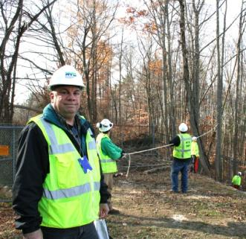
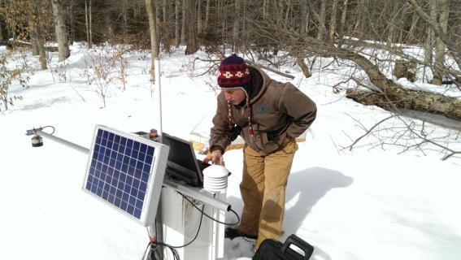

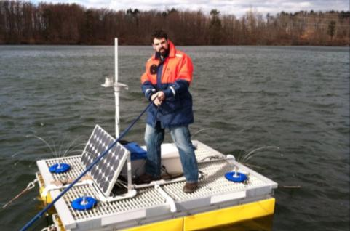
Who works on the water supply?
It takes all kinds of people to deliver 1 billion gallons of water to 9.5 million people every day.
Water scientists
Police officers
Meteorologists
Foresters
Instrumentation specialists
Biologists
Groundskeepers
Engineers
Purchasing experts
Admin. assistants
Sewer plant operators
Truck drivers
Planners
Land stewards
Lawyers
Communications experts

Slide 35
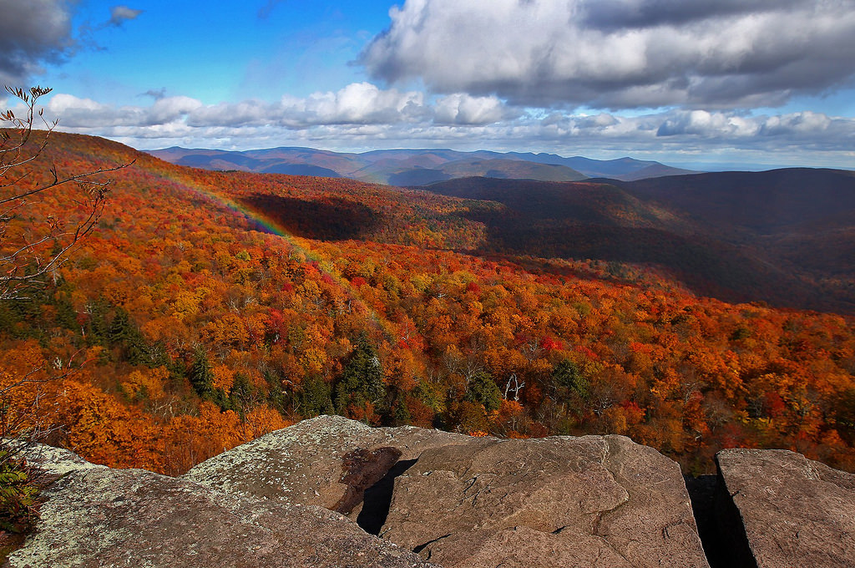
Questions and discussion…

Slide 36
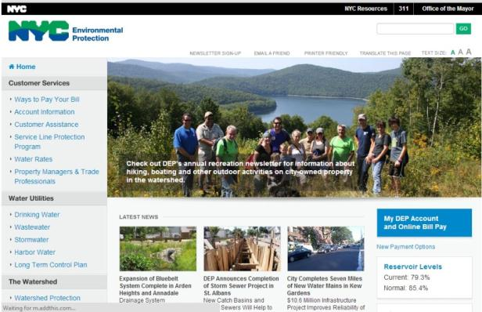
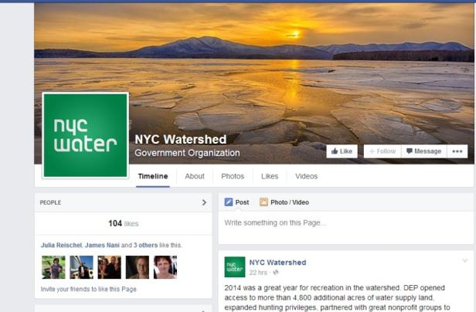
For more information…
Visit the DEP website at www.nyc.gov/dep
Follow us on Facebook
for more info about events and projects, photos and other watershed updates:
facebook.com/nycwatershed

